Slide 1







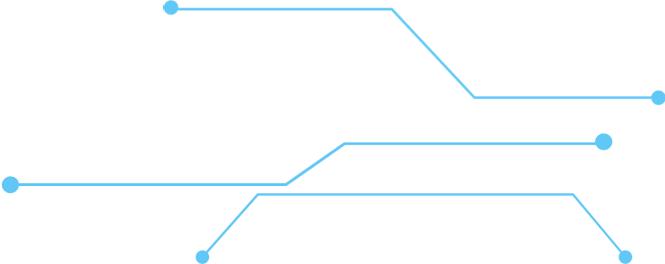
Generative
ARTIFICIAL INTELLIGENCE
By Irving Castillo, AJ Estrella, Edison Cheng, Derrick J Sanchez
PRESENTATION
Notes:
Your team has been engaged by one of the largest thinktanks to help
Propose policy suggestions to help minimize the potential negative impact
of bias,
illegal use of data, and copyright protection.

Slide 2


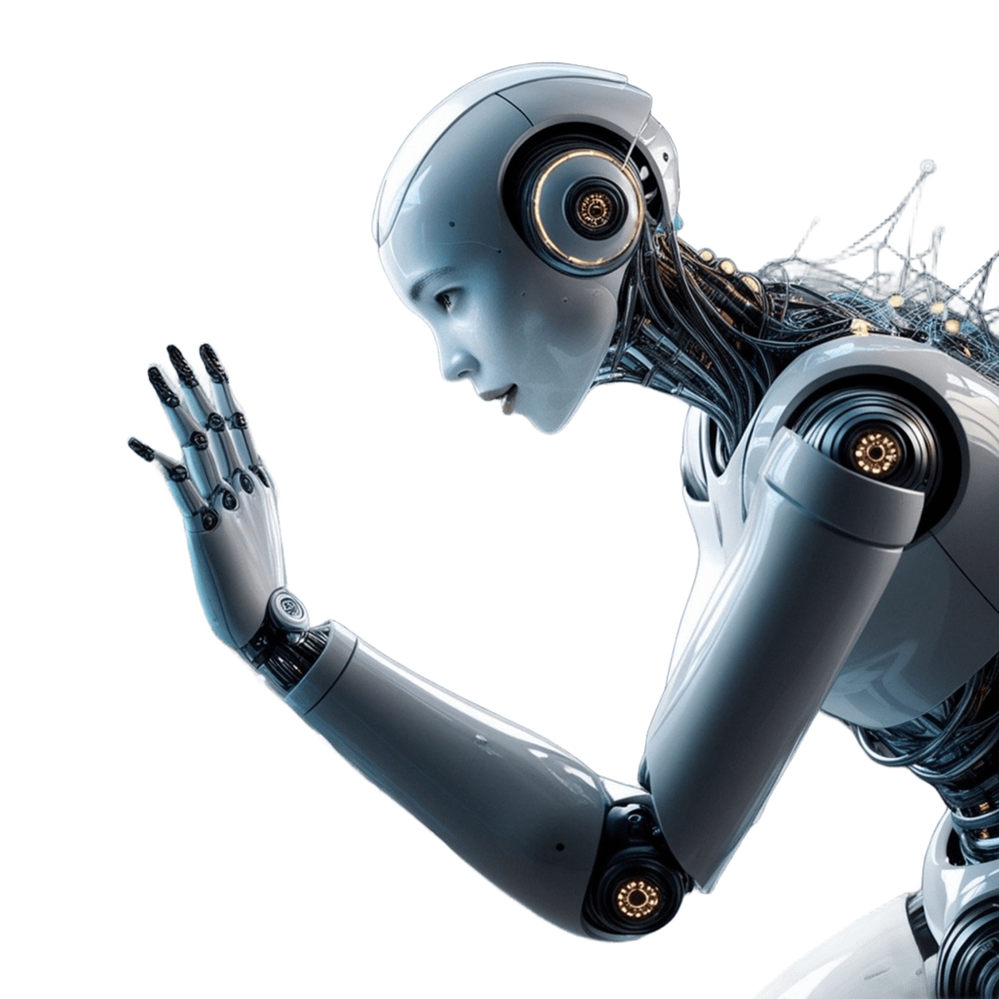



Context:
Generative AI can save you time, no matter what
field you work in. It can create content for marketing,
forecast numbers for finance, or code for software
developers. Publicists can use it write press releases.
Health professionals can even use it to improve their
diagnosis. You, the worker, are still in charge, you just
have more freedom to strategize, think big, and excel.
Your team has been engaged by one of the largest
think tanks to help propose policy suggestions to help
minimize the potential negative impact of bias, illegal
use of data, and copyright protection.

Slide 3
Intro to G.A.I. (Impact)
Generative Artificial Intelligence (G.A.I.)
Popular examples are ChatGPT, Google’s Gemini, Microsoft Copilot
https://en.wikipedia.org/wiki/Generative_artificial_intelligence
https://news.mit.edu/2023/explained-generative-ai-1109
https://www.ibm.com/topics/generative-ai
https://spectrum.ieee.org/what-is-generative-ai
https://www.oracle.com/artificial-intelligence/generative-ai/what-is-generative-ai/
https://yellow.ai/blog/types-of-generative-ai/

Slide 4
Intro to G.A.I. (Impact)
Generative Artificial Intelligence (G.A.I.)
Popular examples are ChatGPT, Google’s Gemini, Microsoft Copilot
AI Subset that uses “generative models”
Potential misuse of generative AI
Intellectual property law
Generative AI relies on sophisticated machine learning models called deep learning models—algorithms that simulate the learning and decision-making processes of the human brain.
Generative AI has uses across a wide range of industries
software development
Healthcare
Finance
Entertainment
Customer service
Sales and marketing
Art, writing
Fashion
Product design

Slide 5
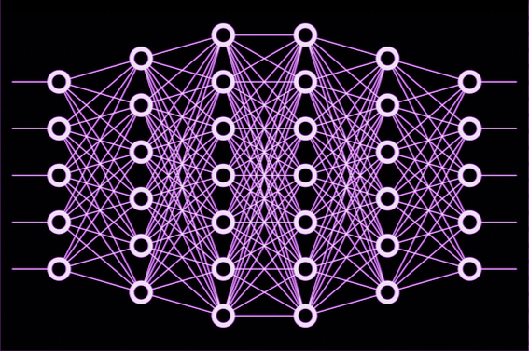
A Brief History of G.A.I. (Edison)
Spoken of in early history
Seen the start in 1950s
Neural networks with machine learning
In 2017, machine learning advancement leads to the first generative pre-trained transformer known as GPT
Generative AI boom (2020-)

Slide 6
Applicable Technology(AJ)
Application Technology of Generative AI has drastically changed the industries
Content Creation is assisting within generating for the media
Predictive Analysis is improving the accuracy of simulation advancement
Data Augmentation is to make datasets for research purposes
Personal Experiences improving your preferences and recommendations

Slide 7
Impact(AJ)
Content Creation: Engages with the audiences and does phenomenal work with the search engines; Heinz used this method and enhanced their ad campaign videos
Personal Experiences: Engages not only with the people but students as well in the education system, exceeding expectations based on real-time progresses and needs; one example would be MATHia system which is by Carnegie Learning
Gaming Realm: Creativity has been great for game designs and virtual simulations as NVIDIA uses generative AI for simplistic drawings to become a realistic drawing
Coding Language: Automating coding in a drastic manner, as can support and help challenging codes, suggesting coding lines that can be useful, and this is one of example from GitHub Copilot including open sources

Slide 8
Bias in Generative AI (Irving)
Generative AI models are trained by large data sets such as textbooks or books. In many cases these sources have biases because they were developed by an actual person.
A user prompting a generative AI model to describe the role of X country in World War 2. The model may prove to have biases towards that said country by painting the country’s intervention in the war as a necessary call to action and not exploring alternate perspectives.
Biases in AI can lead to viewpoints that are damaging or offensive to a specific group of people.
Many people use generative AI as a learning method, thus more chances of biases being instilled in people unknowingly. In other words, they don’t get the full picture.

Slide 9
Data Privacy Concerns (Irving)
Generative AI often uses large data sets for training purposes. The question lies on what type of information shared is being used to train the model.
In many instances, information that a user shares with these models are used i.e: personal information, screenshots
Ensuring that companies that offer generative AI services sustain a transparent communication with users on what data of theirs is collected and its intended purpose.

Slide 10
Copyright Infringement Concerns (Irving)
Copyright concerns stem from generative AI models being trained off from copyrighted material.
This make it so answers to user prompts are direct or slight copies of other licensed work.
There has to be an effort on the part of companies to ensure that their models are not trained on licensed work to avoid any legal trouble
Certain prompts can make generative AI suggest websites that allow unlawful access or download links to copyrighted material.

Slide 11







Minimizing effects of Bias (Derrick)
Data Pre-Processing
Diverse Human Governance
Data Post-Processing
Since bias can enter at any point, making sure the use of AI is looked over by parties of different backgrounds will help with fair data being fed to AI
Most bias comes from the data fed to the AI, making sure the data is bias free before can help mitigate
If bias still does manage to come out, making sure they are detected after the AI is used to filter these biases out.
Notes:
Derrick

Slide 12






SERVICE
Minimizing effects of Illegal Use of Data (Derrick)
PIAs must be conducted regularly
Obtain Consent
Conduct privacy impact assessments to identify potential issues before they become major problems
Keeps record of data collection to avoid any type of data fraud or misuse
Be Transparent of Use
Implement Data Security methods
Helps users trust you and allows for more trustworthy data
Penetration Testing and Vulnerability assessments must be conducted regularly for security
Notes:
Derrick:
A PIA involves a detailed analysis of how data is collected, processed, stored, and deleted, identifying risks to privacy at each stage. It also requires evaluating the necessity and proportionality of data processing, ensuring that only the minimum amount of data necessary for the project's objectives is used.

Slide 13


Minimizing effects of Copyright (Derrick)
Use non-infringement AI tools
Hire an AI focused Legal Team
Stick to tools that explicitly allow output to be used for commercial use
The law is still evolving in this issue, having a team allows for any dispute to be solved if any
CORPORATE RESPONSIBILITY AI
Adapting as the Law Adapts
There must be human governance over what sources need to be credited
Having individuals using the AI also be up to date with the law surrounding these issues is critical

Slide 14
Conclusion (Derrick)
AI is a wonderful piece of technology that can revolutionize the world in many aspects
Through its process of deep learning it can generate resources that accelerate the growth of many fields such as health care, finance, programming, etc
However, there are potential negative aspects of AI that can ruin these benefits including data privacy, copyright infringement and bias
If a company would like to use generative AI they must follow strict policies like the ones mentioned before in order to reduce the effects of these aspects

Slide 15
Sources
https://aibusiness.com/responsible-ai/address-bias-in-generative-ai-to-unlock-benefits-while-minimizing-risk#close-modal
https://www.sap.com/resources/what-is-ai-bias
https://www.spotdraft.com/blog/mitigating-privacy-issues-around-ai
https://www.dataquest.io/blog/what-is-generative-ai/
https://hai.stanford.edu/news/privacy-ai-era-how-do-we-protect-our-personal-information
https://en.wikipedia.org/wiki/Generative_artificial_intelligence
https://news.mit.edu/2023/explained-generative-ai-1109
https://www.ibm.com/topics/generative-ai
https://spectrum.ieee.org/what-is-generative-ai
https://www.oracle.com/artificial-intelligence/generative-ai/what-is-generative-ai/
https://yellow.ai/blog/types-of-generative-ai/

